Slide 1


Spring Cloud

Slide 2
Objective
Define spring Cloud and Netflix OSS
Developing application using spring cloud – Netflix Eureka
Developing and demonstrating Netflix Discovery server and Client
Developing and Demonstrating Netflix config Server
Developing and demonstrating Netflix Zuul
Developing and demonstrating Netflix Ribbon
Developing application for Circuit barker pattern and hystrix dashboard

Slide 3
Spring Cloud
The Spring Cloud project is an umbrella project from the Spring team that implements a set of common patterns required by distributed systems, as a set of easy-to-use Java Spring libraries.
Despite its name, Spring Cloud by itself is not a cloud solution.
Rather,it provides a number of capabilities that are essential when developing applications targeting cloud deployments that adhere to the Twelve-Factor application principles.
https://12factor.net/
Facilitates the Cloud Native styles
Common features required by all the components in a distributed system
Distributed/versioned configuration
Service registration and discovery
Routing
Service-to-service calls
Load balancing
Circuit Breakers
Global locks
Leadership election and cluster state
Distributed messaging
Cloud Native :
“… a software application that is specifically built for cloud computing

Slide 4



Spring Cloud
Spring Cloud for Cloud Foundry
Spring Cloud for Amazon Web Services
Spring Cloud Bus
Spring Cloud ...
Spring Cloud Config
Spring Cloud Netfix
Spring Cloud Consul
Spring Cloud Context
Spring Cloud Commons
Spring Boot
Spring

Slide 5
Components of Spring Cloud
Each Spring Cloud component specifically addresses certain distributed system capabilities.

Slide 6
Why Micro Services Architecture?
We chose micro services architecture to write each functionality as a separate service for core and API functionality and it helps us to achieve the continuous delivery and integration.

Slide 7
Patterns in Micro services Architecture

Slide 8
Micro services Architecture via Netflix Components
We have used the Netflix components to accomplish the above micro services architecture patterns
Operations Component | Spring, Netflix OSS
Service Discovery server | Netflix Eureka
Edge Server /Gateway | Netflix Zuul
Central configuration server | Spring Cloud Config Server
Dynamic Routing and Load Balancer | Netflix Ribbon
Monitoring | Netflix Hystrix dashboard and turbine
OAuth 2.0 protected API's | Spring Cloud + Spring Security OAuth2

Slide 9
Spring Boot & Spring Cloud Netflix OSS – Micro Service Architecture

Slide 10
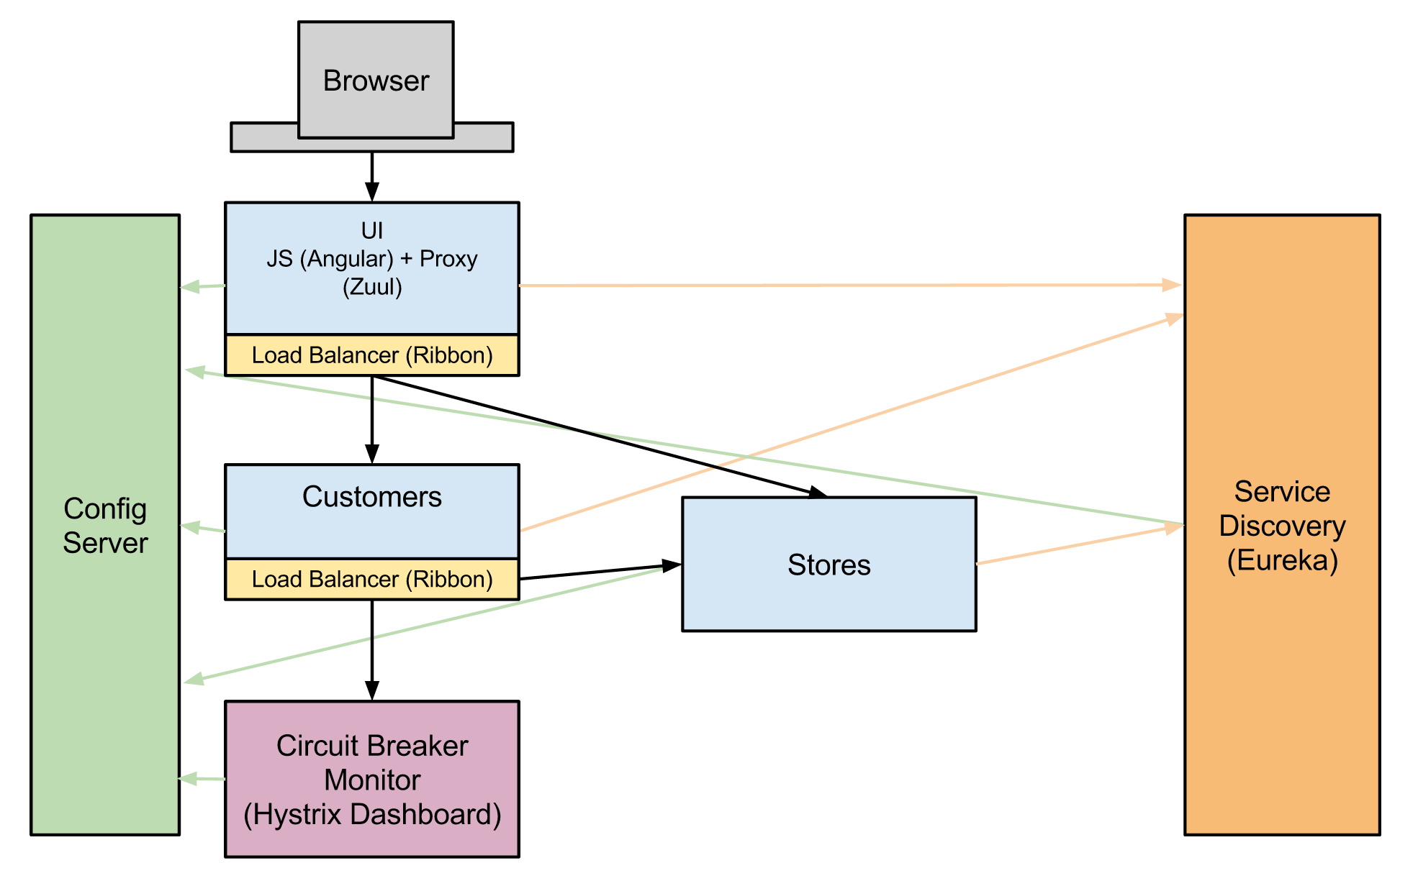
Example: Spring Cloud + Netflix OSS

Slide 11
Service Registration/Discovery
Service discovery provides:
A way for a service to register itself
A way for a service to deregister itself
A way for a client to find other services
A way to check the health of a service and remove unhealthy instances
Discovering Services With Spring Cloud
Spring Cloud Consul
Spring Cloud Zookeeper
Spring Cloud
Netflix
Key Components in Service Discovery
Discovery Server
Service
Client
Annotations:
@EnableEurekaServer
@EnableDiscoveryClient
Using SpringCloudEurekaServer:
<dependency>
<groupId>org.springframework.cloud</groupId>
<artifactId>spring-cloud-starter-netflix-eureka-server</artifactId>
</dependency>
And :
<dependencyManagement>
<dependencies>
<dependency>
<groupId>org.springframework.cloud</groupId>
<artifactId>spring-cloud-dependencies</artifactId>
<version>${spring-cloud.version}</version>
<type>pom</type>
<scope>import</scope>
</dependency>
</dependencies> </dependencyManagement>

Slide 12
Spring Cloud Config
The Spring Cloud Config server is an externalized configuration server in which applications and services can deposit, access, and manage all runtime configuration properties.
The Spring Config server also supports version control of the configuration properties.
The Spring Config server stores properties in a version-controlled repository such as Git or SVN.

Slide 13
Config Server
Application Configuration Server
Dedicated, dynamic, centralized key/value store (may be distributed)
Authoritative source
Auditing
Versioning
Cryptography support
Managing Application Config tools :
Spring Cloud Consul
Spring Cloud Zookeeper
Spring Cloud Config
Spring Cloud Config provides server and client-side support for externalized configuration in a distributed system.
Annotations :
@EnableDiscoveryClient
@EnableConfigServer
Using Spring Cloud Config Server:
<dependency>
<groupId>org.springframework.cloud</groupId>
<artifactId>spring-cloud-config-server</artifactId>
</dependency>
<dependency>
<groupId>org.springframework.cloud</groupId>
<artifactId>spring-cloud-starter-netflix-eureka-client</artifactId>
</dependency>
dependencyManagement>
<dependencies> <dependency>
<groupId>org.springframework.cloud</groupId>
<artifactId>spring-cloud-dependencies</artifactId>
<version>${spring-cloud.version}</version>
<type>pom</type> <scope>import</scope>
</dependency></dependencies>
</dependencyManagement>

Slide 14
Intelligent Routing with Spring Cloud & Netflix Zuul
Routing in cloud native apps:
Netflix Zuul
Proxy server
Setting up routes
API Gateway
… a single entry point for all clients …
-Chris Richardson
Netflix Zuul
Zuul is a gateway service that provides dynamic routing, monitoring, resiliency, security, and more.
Annotations :
@EnableZuulProxy
Gate Way Service Implementation :
<dependency>
<groupId>org.springframework.cloud</groupId>
<artifactId>spring-cloud-starter-netflix-eureka-client</artifactId>
</dependency>
<dependency>
<groupId>org.springframework.cloud</groupId>
<artifactId>spring-cloud-starter-netflix-zuul</artifactId>
</dependency>

Slide 15
Load balancing
… improves the distribution of workloads across multiple computing resources …
Load balancing types :
Server-side
Client-side
Client-side load balancing is a natural fit for cloud native architectures.
Netflix Ribbon
Ribbon is a Inter Process Communication (remote procedure calls) library with built in software load balancers.
Implement Full integration with Spring’s RestTemplate.
Annotations Used :
@LoadBalanced
Ribbon Service :
<dependency>
<groupId>org.springframework.cloud</groupId>
<artifactId>spring-cloud-starter-netflix-eureka-client</artifactId>
</dependency>
<dependency>
<groupId>org.springframework.cloud</groupId>
<artifactId>spring-cloud-starter-netflix-ribbon</artifactId>
</dependency>

Slide 16
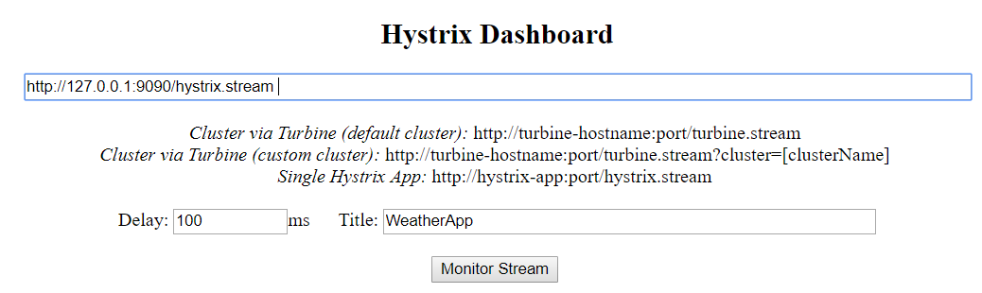
Fault tolerance and Circuit breaker
Cascading Failure
“ … a failure in a system of interconnected parts in which the failure of a part can trigger the failure of successive parts.”
Circuit Breaker Pattern
“… a design pattern in modern software development used to detect failures and encapsulates logic of preventing a failure to reoccur constantly …”
Netflix Hystrix
Hystrix is a latency and fault tolerance library designed to stop cascading failure and enable resilience in complex distributed systems where failure is inevitable.
Annotations :
@EnableCircuitBreaker
@HystrixCommand(fallbackMethod="unknown")
Fault Tolerance with Netflix Hystrix and Spring Cloud:
<dependency>
<groupId>org.springframework.cloud</groupId>
<artifactId>spring-cloud-starter-netflix-hystrix</artifactId>
</dependency>
Running Hystrix Application
Open Dashboard App : http://localhost:8080/hystrix.stream

Slide 17
Thank You

Slide 18

www.infogain.com
Infogain Corporation, HQ
485 Alberto Way Los Gatos, CA 95032 USA
Phone: 408-355-6000
Fax: 408-355-7000
Pune
7th Floor, Bhalerao Towers, CTS No.1669 - 1670, Behind Hotel Pride,
Shivaji Nagar, Pune - 411005
Phone : +91-20-66236700
Infogain Irvine
41 Corporate Park, Suite 390 Irvine, CA 2606 USA
Phone: 949-223-5100
Fax: 949-223-5110
Infogain Austin
Stratum Executive Center Building D 11044 Research Boulevard Suite 200
Austin, Texas 78759
Noida
A-16, Sector 60, Noida Gautam Budh agar, 201301 (U.P.) India
Phone: +91-120-2445144
Fax: +91-120-2580406
Dubai
P O Box 500588 Office No.105, Building No. 4, Dubai Outsource Zone,
Dubai, United Arab Emirates
Tel: +971-4-458-7336

